Slide 1

Linear Regression

Slide 2
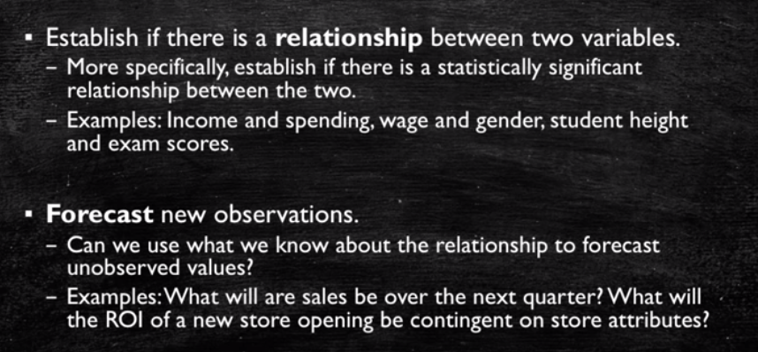
Linear Regression Objectives

Slide 3

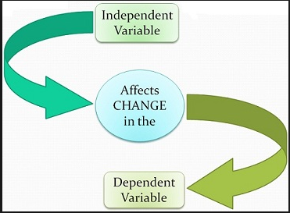
Types of Variable
Dependent Variable
Variable whose value we want to explain or forecast
Its value depends on something else
Denoted by ‘Y’
Independent Variable
Variable which explain the other one
Also called Explanatory variables
Denoted by “X’s”

Slide 4
Linear Regression Model
Relationship Between Variables Is a Linear Function
Population Y-Intercept
Population Slope
Random Error
Y
=
β
+
β
X
+
ε
i
0
1
i
i
Dependent (Response) Variable
Independent (Explanatory) Variable

Slide 5
Linear Equations
© 1984-1994 T/Maker Co.
Notes:
28

Slide 6
Scatter plot
1. Plot of All (X_{i}, Y_{i}) Pairs
2. Suggests How Well Model Will Fit
Y
60
40
20
0
X
0
20
40
60

Slide 7
Fitting a Line
How would you draw a line through the points? How do you determine which line ‘fits best’?
Slope changed
Y
Y
60
60
40
40
20
20
0
X
0
X
0
20
40
60
0
20
40
60
Intercept unchanged
Notes:
42

Slide 8
Fitting a Line
How would you draw a line through the points? How do you determine which line ‘fits best’?
Slope unchanged
Slope changed
Y
Y
60
60
40
40
20
20
0
X
0
X
0
20
40
60
0
20
40
60
Intercept changed
Intercept changed
Notes:
42

Slide 9
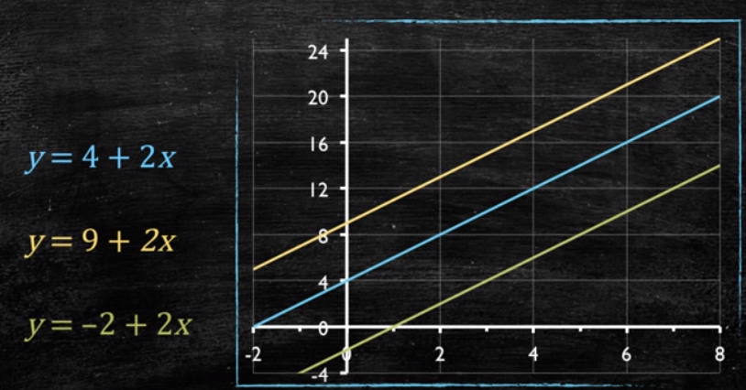
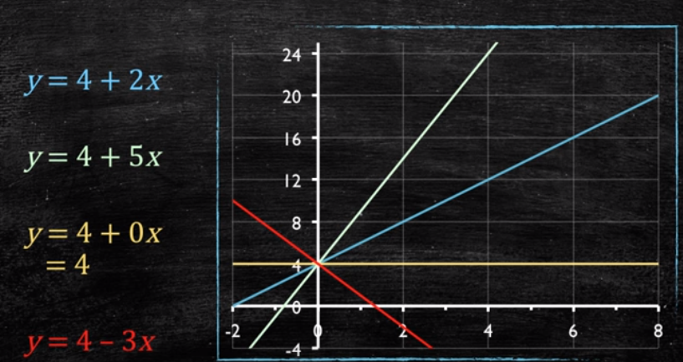
Changing the Slope vs Intercept
Changing the intercept
Changing the Slope
Notes:
42

Slide 10
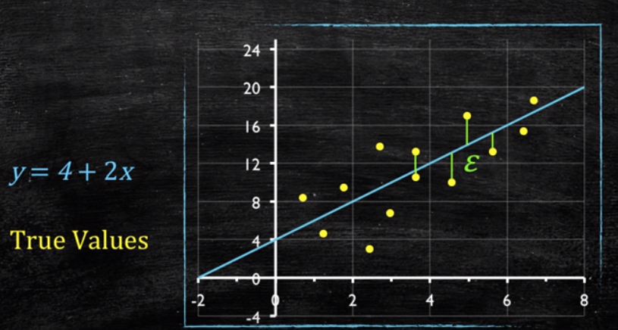
Sadly, the world is not linear!
Since the defined linear model does not fit exactly to each data point
Our model should also mention the ‘e’ error term
Model aims to minimize this error term in general
Notes:
42

Slide 11
Least Squares
‘Best Fit’ Means Difference Between Actual Y Values & Predicted Y Values Are a Minimum. But Positive Differences Off-Set Negative. So square errors!
LS Minimizes the Sum of the Squared Differences (errors) (SSE)
Notes:
51

Slide 12
Least Squares Graphically
Notes:
52

Slide 13
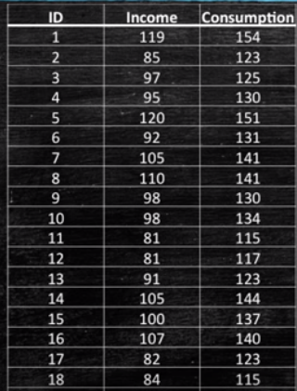
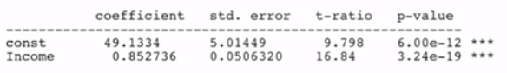
Sample Data with Regression Model Fitting
Find a relationship between Consumption(dependent variable) and Income (independent variable)
Assumption being tested: If Income is a good variable to explain consumption
Sample Result
In general, intercept does not have an intuitive interpretation
0.85: For every unit increase in family income its consumption increases by 0.85 units
Coefficient Interpretation
Notes:
52

Slide 14

BUT!!!
Is Consumption really related to Income?
Is relationship between variables strong enough to claim the relation?
Is the sample size good enough to generalize across all families?
Notes:
52

Slide 15
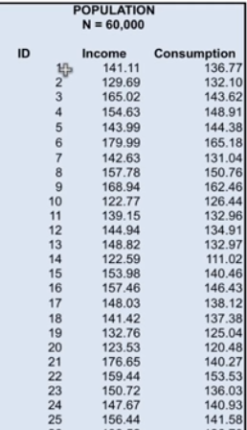
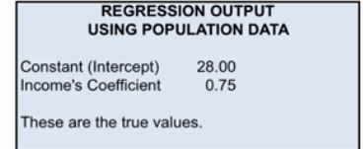
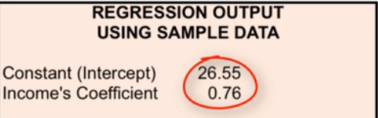
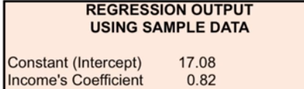
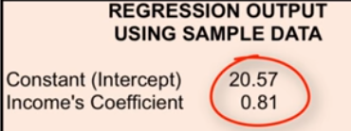
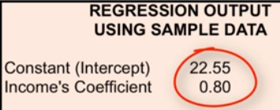
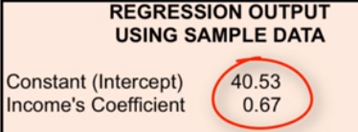
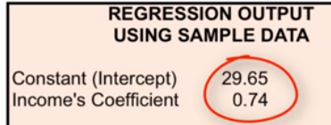
Understanding Sampling Impact
Assuming Total population : 60000 . Fitting a model gave the following result
Randomly selecting 40 samples every time and re-fitting a model, we see the below changes in the model coefficients

Slide 16
What do we learn?
While working with samples, and not the whole population, the point estimate is not necessarily the true values.
Hence, instead of using only point estimate , its always better to talk about a range of values for the coefficient, which is called “Confidence Interval”
A standard practice is to talk about 95% confidence interval, which means we are 95% certain the true value lies within our interval

Slide 17
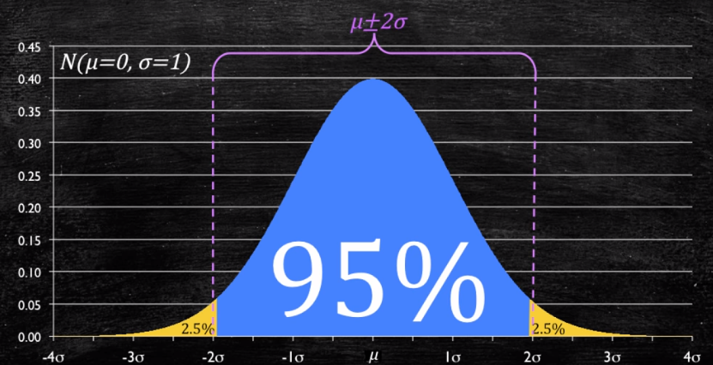

Going Back to Normal Distribution
In a Normal standard distribution with mean 0 and sd=1,
Only 5% of the data lies beyond
Hence we are 95% sure that any random selection of data will lie between
mean +- 2S.D.
In computing our 95% confidence interval, we make a claim that from our point estimate, or the mean value, the true value will lie between “Point estimate +/- 2.S.D.” [in this case standard error of the estaimte]

Slide 18
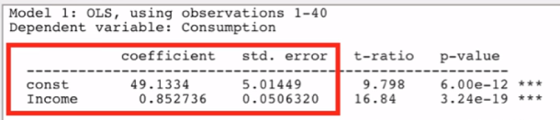
Computing Confidence Interval
Standard error[SE] for each estimate is provide by all statistical tools.
We compute the 95% Confidence Interval as below
“Point estimate +/- 2.S.E.”
Sample Result
So, we get a range of values for the coefficient of Income. But does it answer our main question…
Is there really a strong relationship between Income and Consumption?

Slide 19
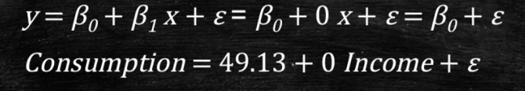
If there was No Relationship?
…Then Consumption will not vary with change in Income i.e. The coefficient of Income in our model would be 0…
So, our aim is to show that slope coefficient is non-zero and hence a relationship exists
Statistically Significant Relationship
Rule of Thumb: If 0 is outside our 95% confidence interval, we claim there is a statistically significant relationship
Formally we reject the null hypothesis that there is no relationship or that 0 is a possible value for the income coefficient

Slide 20
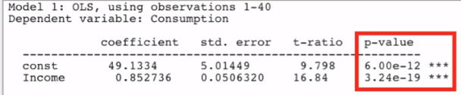
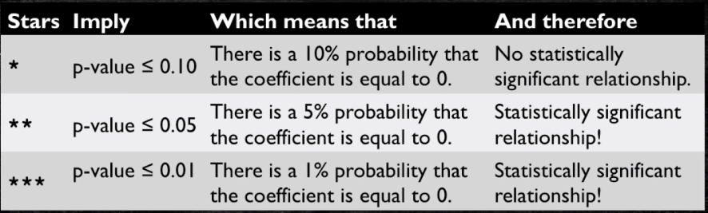
Statistically Significant Relationship(continued)
Another Rule of Thumb: If the p-value is below 0.05(or 5%), we claim the relationship is statistically significant
They are reported as a standard output in all statistical tools
They represent a probability that there is No Relationship between the variables

Slide 21
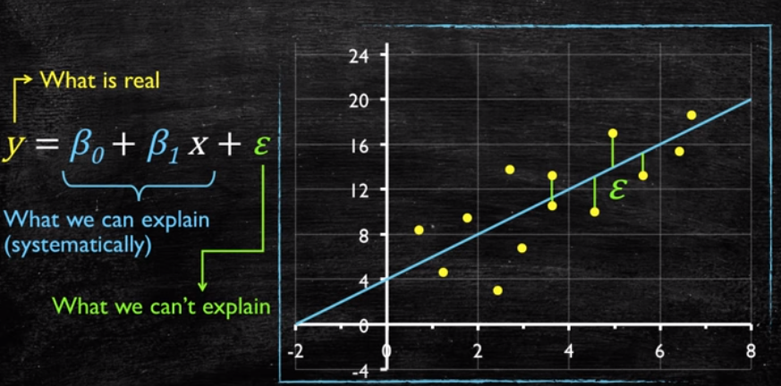
But Some Things we can’t explain….
There is a portion of variability in ‘y’ which can eb explained by the variation in ‘x’
But there is another portion ’e’ which cannot be explained by the model
Hence we measure a model fitment, by comparing the variance we can explain relative to the variance we cannot explain

Slide 22
Simple Linear Regression
Prediction error: ε
Observation: y
^
Prediction: y
Zero
For each observation, the variation can be described as:
y = y + ε
Actual = Explained + Error
^

Slide 23
Regression
Dependent variable
Independent variable (x)
A least squares regression selects the line with the lowest total sum of squared prediction errors.
This value is called the Sum of Squares of Error, or SSE.

Slide 24
Calculating SSR
Population mean: y
Dependent variable
Independent variable (x)
The Sum of Squares Regression (SSR) is the sum of the squared differences between the prediction for each observation and the population mean.

Slide 25
Regression Formulas
The Total Sum of Squares (SST) is equal to SSR + SSE.
Mathematically,
SSR = ∑ ( y – y ) (measure of explained variation)
SSE = ∑ ( y – y ) (measure of unexplained variation)
SST = SSR + SSE = ∑ ( y – y ) (measure of total variation in y)
^
2
^
2
2

Slide 26
The Coefficient of Determination
The proportion of total variation (SST) that is explained by the regression (SSR) is known as the Coefficient of Determination, and is often referred to as R .
R = =
The value of R can range between 0 and 1, and the higher its value the more accurate the regression model is. It is often referred to as a percentage.
2
2
SSR SSR SST SSR + SSE
2

Slide 27
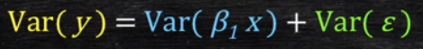
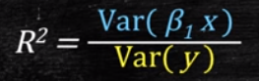
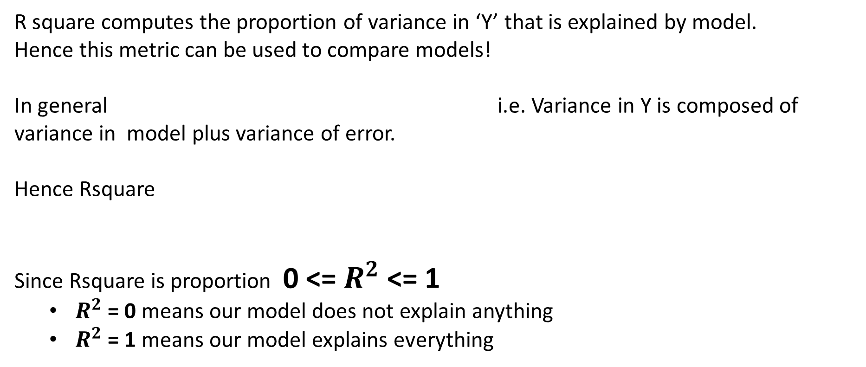
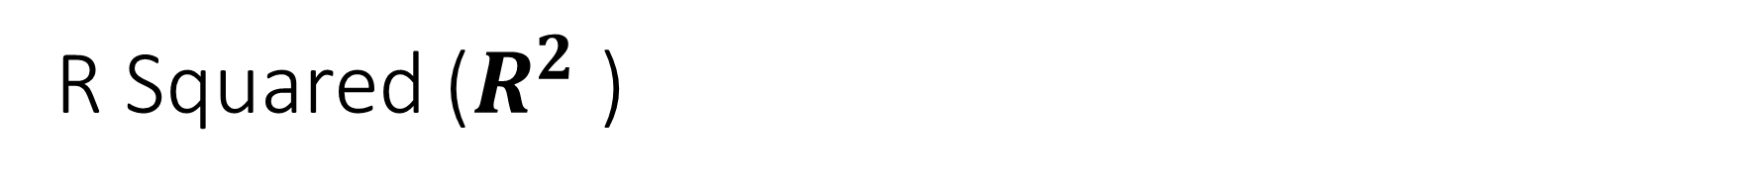
R Squared ($R^{2}$ )
R square computes the proportion of variance in ‘Y’ that is explained by model.
Hence this metric can be used to compare models!
In general i.e. Variance in Y is composed of variance in model plus variance of error.
Hence Rsquare
Since Rsquare is proportion 0 <= $R^{2}$ <= 1
$R^{2}$ = 0 means our model does not explain anything
$R^{2}$ = 1 means our model explains everything

Slide 28
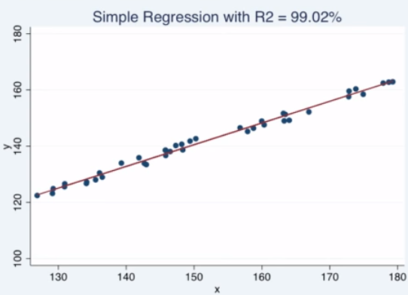
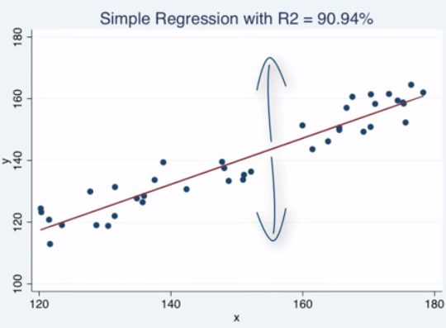
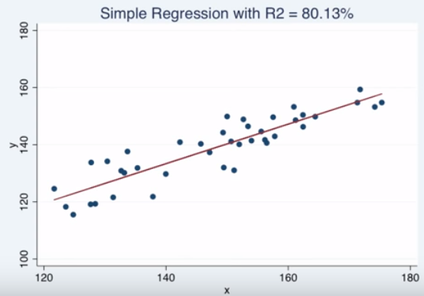
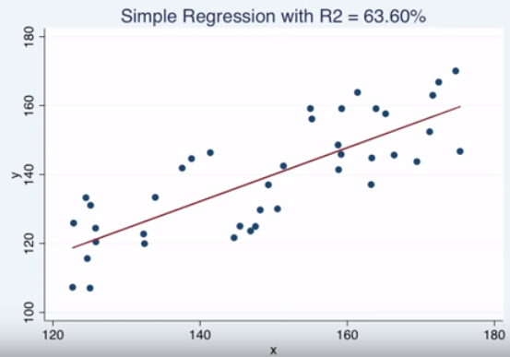
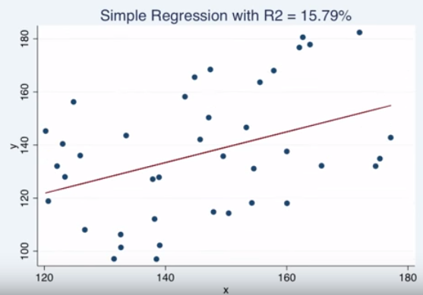

Example $R^{2}$
More the variance of data from the regression fit, lower the R-Square

Slide 29
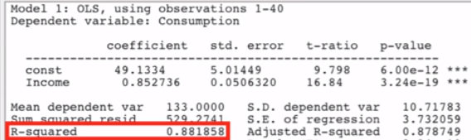
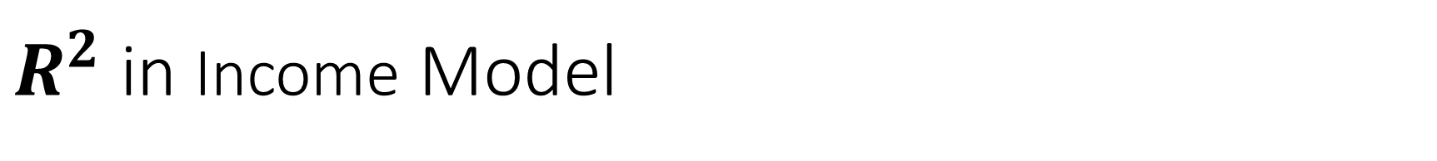
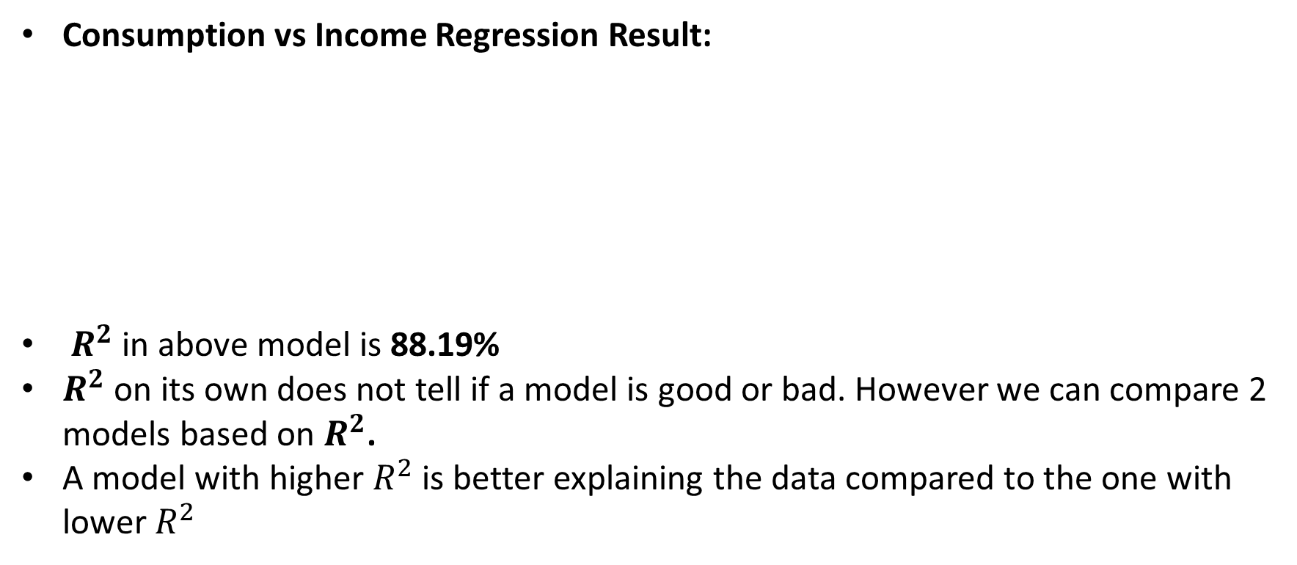
$R^{2}$ in Income Model
Consumption vs Income Regression Result:
$R^{2}$ in above model is 88.19%
$R^{2}$ on its own does not tell if a model is good or bad. However we can compare 2 models based on $R^{2}$.
A model with higher $R^{2}$ is better explaining the data compared to the one with lower $R^{2}$
However there is another important metric in a regression model!

Slide 30
Regression Standard Error(RSE)
Remember that, variance of error term Var(e), is the variance of dependent variable Var(y) , which we cannot explain.
While modeling, our aim is to minimize it
The RSE captures the variance of error term by estimating the standard deviation of error term
Both RSquare and RSE are used to evaluate a Model

Slide 31
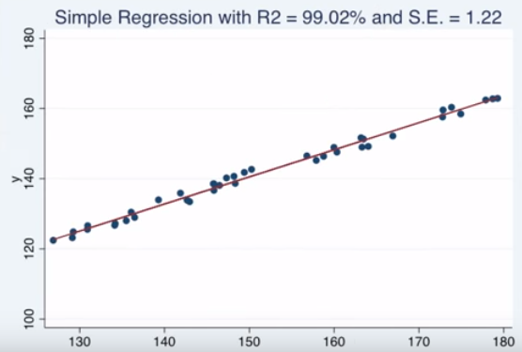
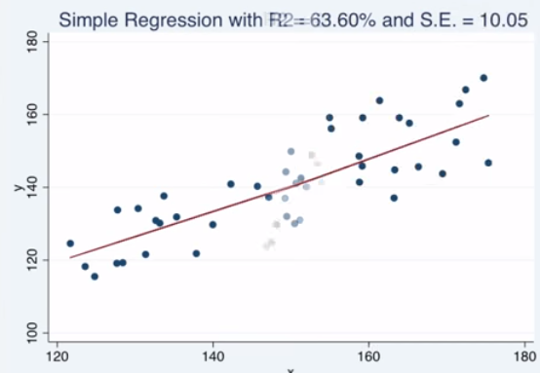
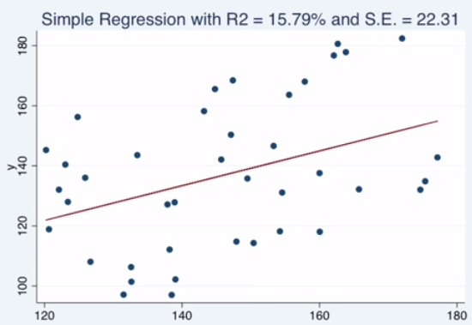
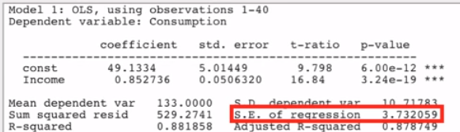
Example R.S.E.
Consumption vs Income RSE Result:
Generally, we see lower the Rsquare higher the Residual Standard Error
For our model, we get an RSE of 3.73

Slide 32
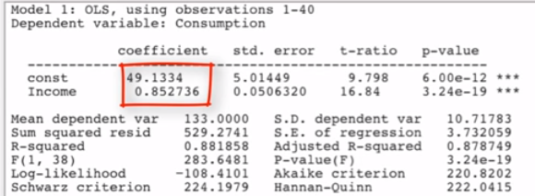
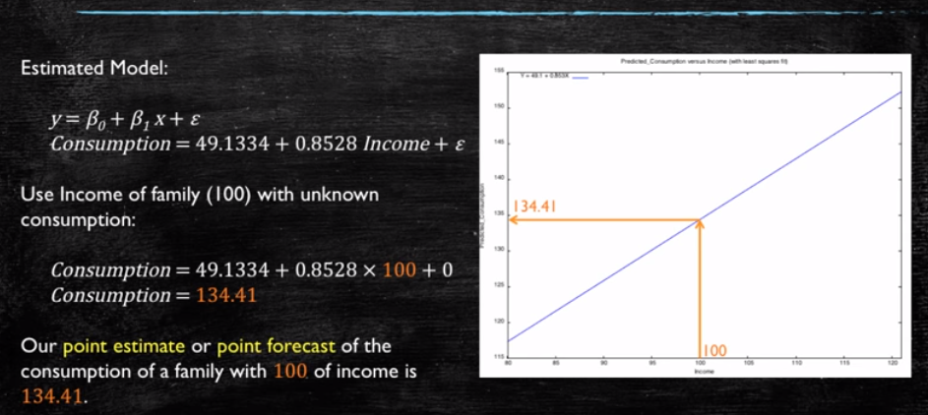
Can we Forecast the Unknown?
What is the expected consumption of a family with 150 of Income?
Steps done till now
Found the model coefficients
Checked that its 95% CI did not include 0
Check the p-value is less than 0.05
Hence we created a statistically significant model
We estimate the point forecast using the model coefficients
But remember, we have certain uncertainty!!!

Slide 33
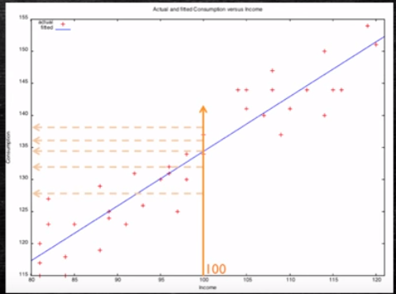
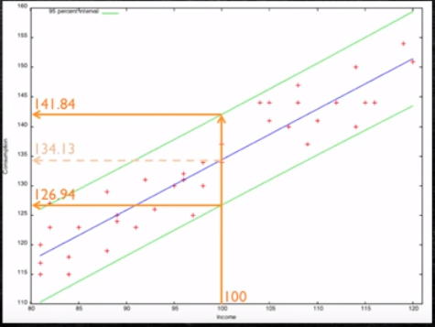
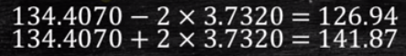
Sampling = Uncertainty
The entire model is based on a sample, and thus our coefficient estimate can have uncertainty
We know the family’s income but are uncertain regrading its consumption
Best thing is to offer a Confidence Interval
Instead of a point forecast construct a 95% confidence interval for our forecast using the RSE

Slide 34
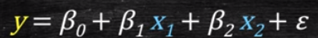
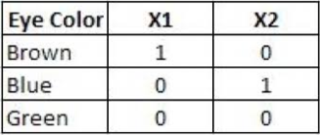
Continuous vs Categorical Variables
Assume regression model
A continuous dependent variable(y): Salary
Continuous Independent variable (x’s): No. of Courses, Publication Count, Years of Experience
Categorical Independent Variable(x’s): Gender, Qualification, University, City etc.
Linear Regression assumes that variables are numbers right????
But, How do we assign numbers to categorical variables?
DUMMY VARIABLES

Slide 35
Dummy Variables
They are called dummy because as they are not real, we create them to represent something else.
Also sometimes called Indicator variables. It has a value of 1 to indicare if observation belongs to a category or 0 to indicate if it does not.
Representing Two Categories
There are 2 categories: Academic and Professionals
We can create a dummy variable to indicate if an observation belong to one of these.
Professional= 1, if observation is Professional
Professional= 0, if observation is Academic
We only need One Binary variable to represent 2 categories

Slide 36
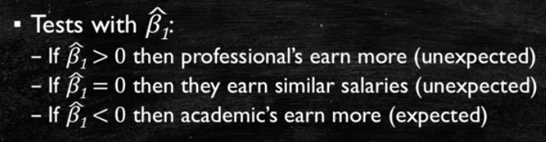
Regressing Salary on Qualification
Model:
What does β1 represent and how do we interpret it?
What is the predicted Salary for an Academic?
What is the predicted Salary for a Professional?

Slide 37
Identifying the Important Variables
Strategy 1:
Individually chose Independently variable based on their statistically significant relationship with the dependent variable
Key Point: Discard any variable that does not have a significant relationship with the dependent variable
We usually use p-value of 0.05(5%) as cutoff. Any variable with higher p-value is discarded
Problems:
Significance level of 5% is an arbitrary decision
Being strict and arbitrary in variable selection
We maybe losing out information that is captured in a combined effect of 2 variables.

Slide 38
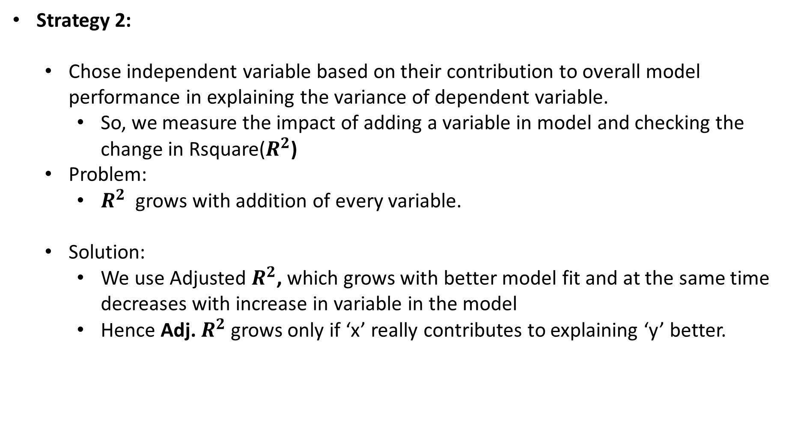
Identifying the Important Variables
Strategy 2:
Chose independent variable based on their contribution to overall model performance in explaining the variance of dependent variable.
So, we measure the impact of adding a variable in model and checking the change in Rsquare($R^{2}$)
Problem:
$R^{2}$ grows with addition of every variable.
Solution:
We use Adjusted $R^{2}$, which grows with better model fit and at the same time decreases with increase in variable in the model
Hence Adj. $R^{2}$ grows only if ‘x’ really contributes to explaining ‘y’ better.

Slide 39
Assumption of Linear Regression
There should be a linear and additive relationship between dependent (response) variable and independent (predictor) variable(s).
The independent variables should not be correlated. Absence of this phenomenon is known as multicollinearity. (Variance Inflation Factor Test)
The error terms must have constant variance. This phenomenon is known as Homoskedasticity.
The error terms must be normally distributed.

Slide 40
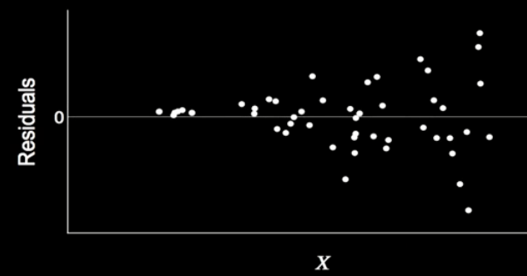
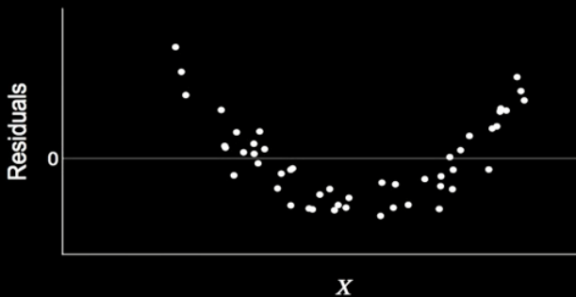
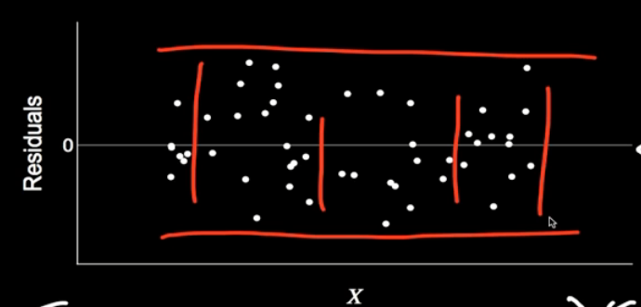
Error Graphs
Problem with Residuals:
Heteroskedasticity
No Problem with Residuals

